Slide 1

Project Proposal Presentation
ITWS-2110 Web Systems Development
Derek, Heidi, Miles, Joseph, Cooper

Slide 2
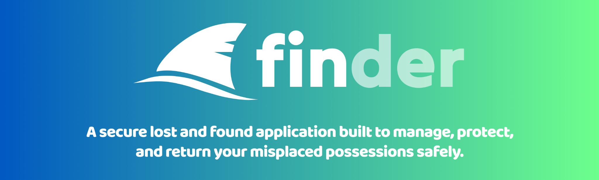

What is Finder?
An matching system for lost possessions (similar to Tinder)
Prioritizes item safety and confidentiality
Notes:
Derek

Slide 3
Summary ( Rationale + How it Works)
APO’s website is not that great and is just a form submission.
When you lose an item you would be in a rush and would want an immediate response not a popup saying form submitted.
Matching system
Reputable RPI individuals (APO members, RAs, and Professors) would submit the item to our website with a query of descriptions(time, location, item type, etc.)
The lost item owners would submit a form with a list of descriptions of the items and the site will automatically match two and two together.
We wanted to create a safe and secure system so that people couldn’t just take an item that wasn’t theirs.
Notes:
Derek

Slide 4

Users
Lost Items Owners (RPI Students and Faculty)
Description: These are the primary users, they are the ones that are trying to find the items that they lost. They submit detailed descriptions of their lost items, including location, time, and a general description.
Value: Our platform provides a quick and reliable way to recover lost items. It is more assuring then using the APO website as our service provides immediate feedback as we attempt to match them with an item submitted to us.
Finders (Trusted Individuals: APO Members, RA’s, Professors)
Description: These users are the ones that reports lost items that they found.
Value: Our platform enables these individuals to quickly match found lost items to their rightful owners. This reduces headache and administrative burden, and makes the lost and found much more efficient instead of using an outdated system.
Notes:
Cooper

Slide 5
Stakeholders
Administrative Staff (Public Safety, APO)
Description: These stakeholders are the ones that actually returns the items.
Value: The system improves efficiency by reducing workload and reduces the confusion that can arise from RPI’s lost and found process.
RPI Campus Community
Description: Even though they might not have lost an item our product provides them reassurance that there is a easy way to find lost items on campus.
Value: Our platform fosters a sense of trust and community by providing a reliable way to find lost items without needing to go to the Pubsafe and APO directly and asking.
Notes:
Cooper

Slide 6






Tech Stack
HTML, CSS, Javascript for the frontend
PHP, MariaDB. And SQL for the backend
We are planning to use PHPmailer or PHP mail() to verify rpi emails.
Notes:
Joe

Slide 7
Functional/Non-Functional Requirements
Functional: Have a database that stores lost item descriptions with multiple fields
Non-Functional: Search through this database, and make it easily scalable and appendable. Make it dynamic, not static as it will need to be updated often.
F: Verify that users actually go to RPI
Non-Function: have Users enter an RPI email and send them a confirmation email. Once, and only once the email is verified (they access the email through their inbox) can they place queries for lost items
F: Prevent spam in terms of misusing the database and trying to get hits for lost and found items that aren't actually theirs.
NF: Implement an submission cooldown using Javascript where Users can only submit one form every 6 hours. Also be sure to notify the user of this
Also will be sure to not include the ability to make edits to a 'missing item' once the query has been submitted
F: Verify That Recorder is supposed to be a recorder
NF: Have a Recorder Passkey that they would enter when logging in which would check a 'recorder' passkey database to make sure they have permissions.
Notes:
Joe

Slide 8
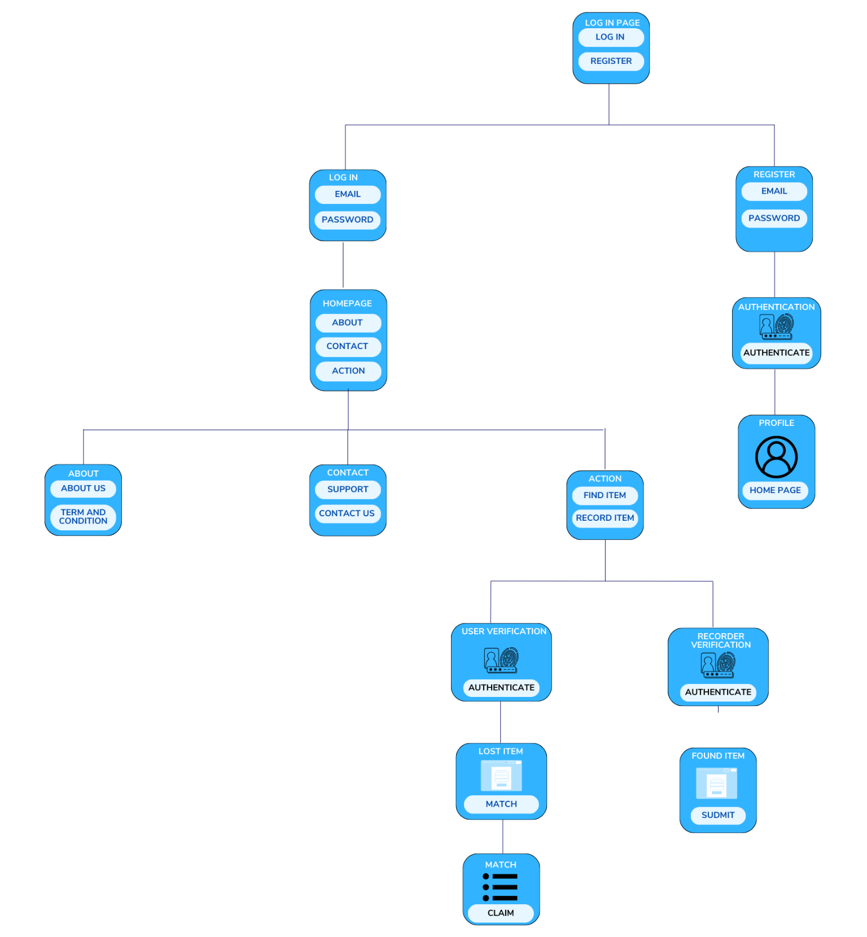
Sitemap
Notes:
Heidi

Slide 9
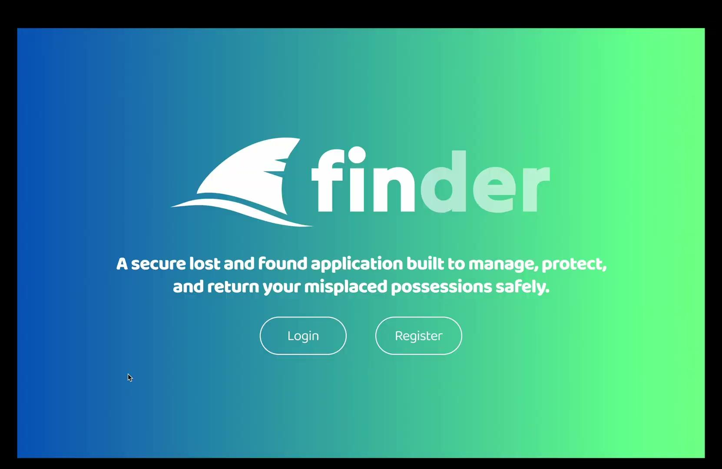
Wireframes
Notes:
Miles

Slide 10
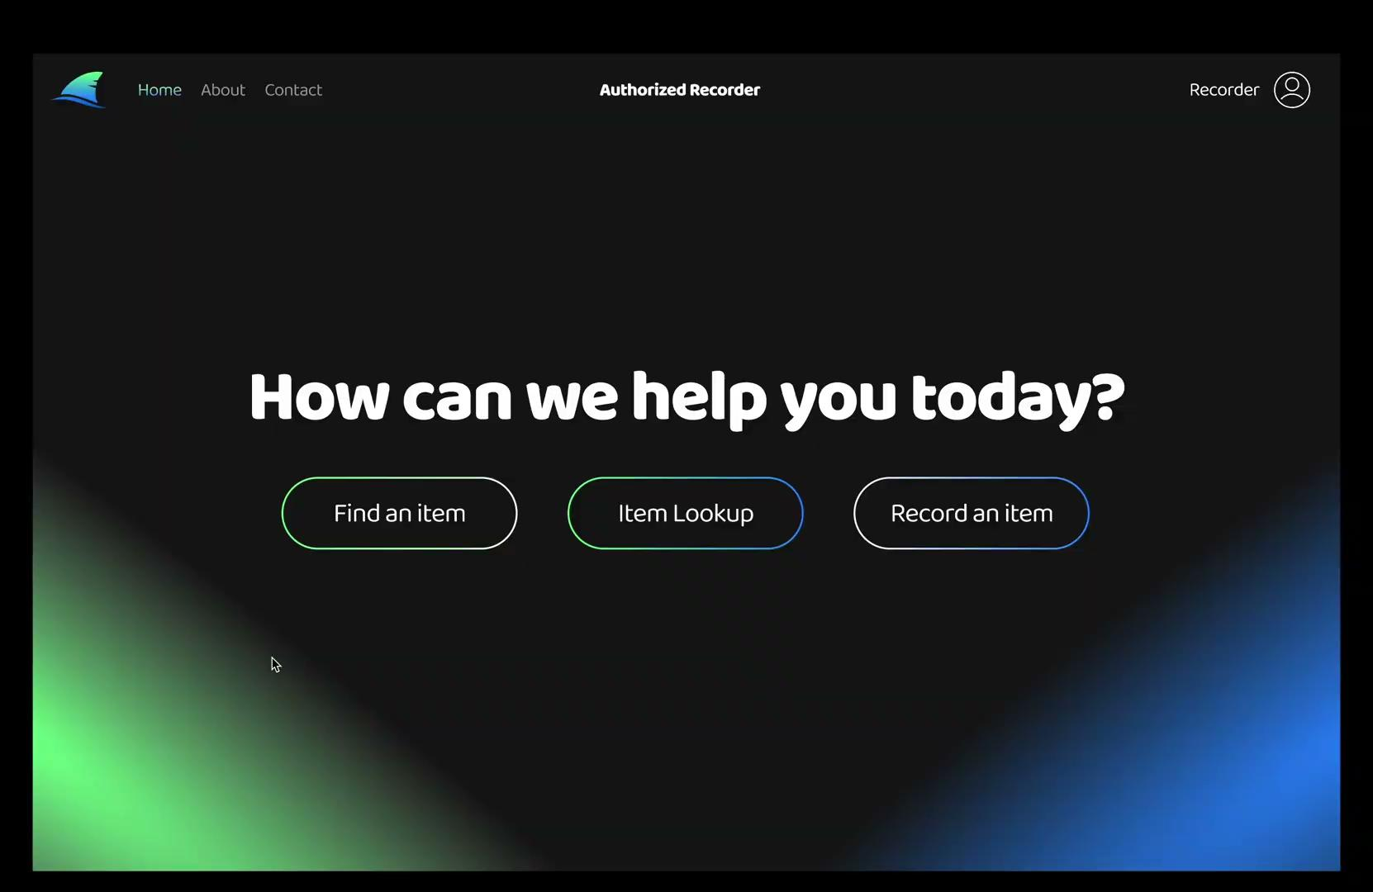
Wireframes
Notes:
Miles

Slide 11
Thank you!
Questions?

